Slide 2
Set up guide
Go to https://www.anaconda.com/products/individual#windows

Slide 3
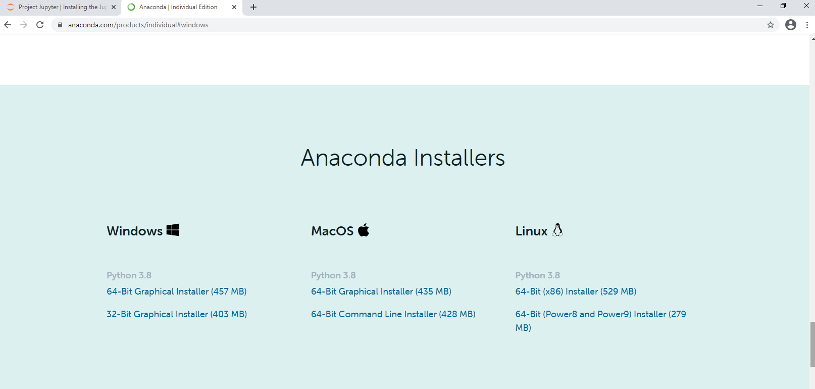
Set up guide
Scroll down and click 64-Bit graphical installer

Slide 4
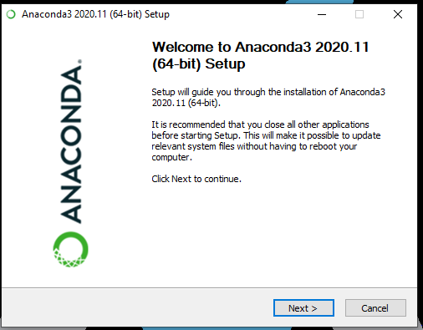
Set up guide
Once the download is complete, run the installer.
The installer should appear like below.

Slide 5
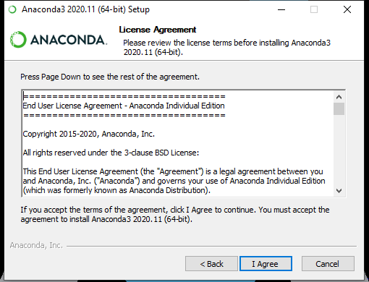
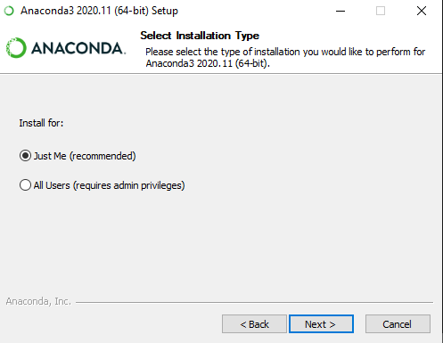
Set up guide
Click next,
Then agree,
Then next again

Slide 6
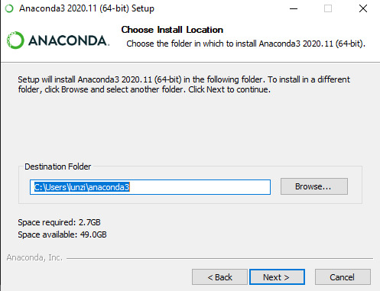
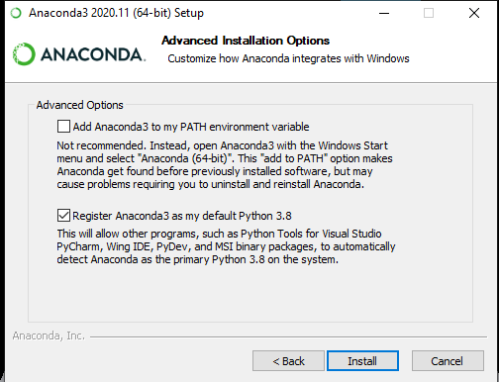
Set up guide
Click next
Then click then Install

Slide 7
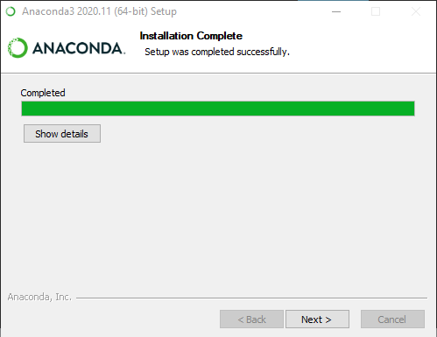
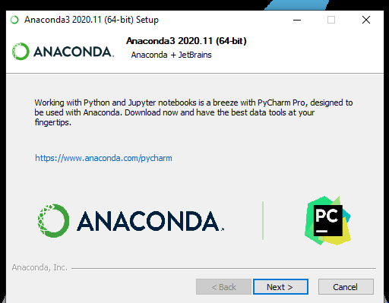
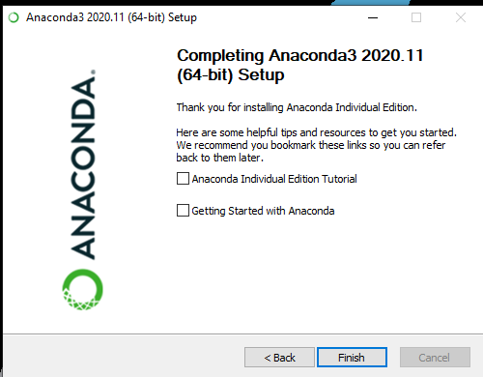
Set up guide
When the installation is done, click next
Then next and finish

Slide 8
Set up guide
Go to https://jupyter.org/

Slide 9
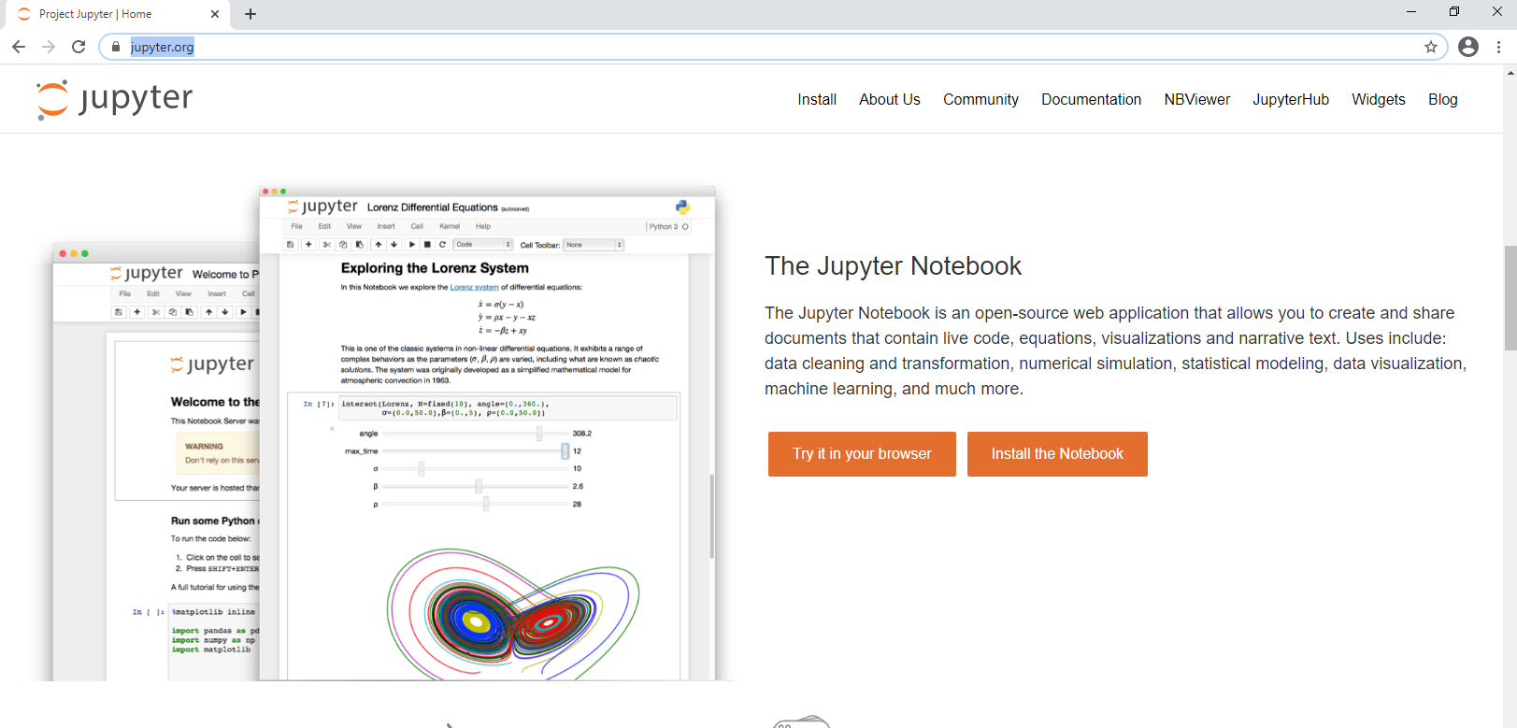
Set up guide
Scroll down to Jupyter Notebook and click install

Slide 10
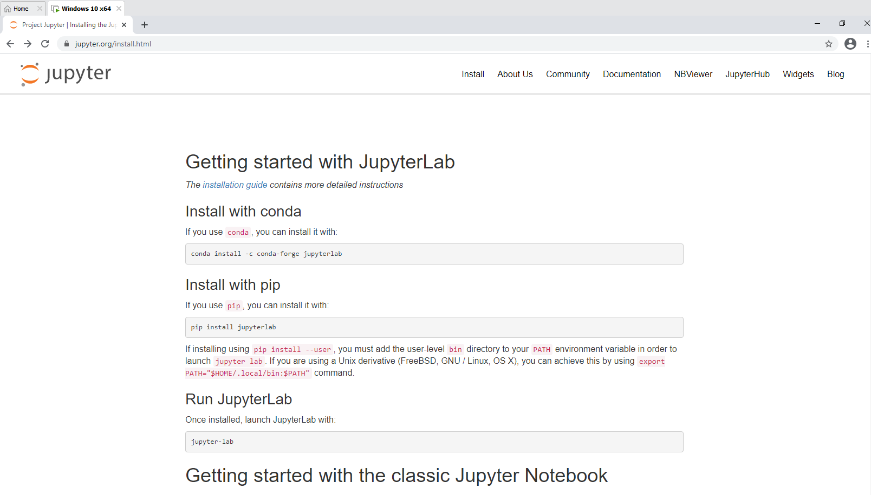
Set up guide
You should be able to see this

Slide 11
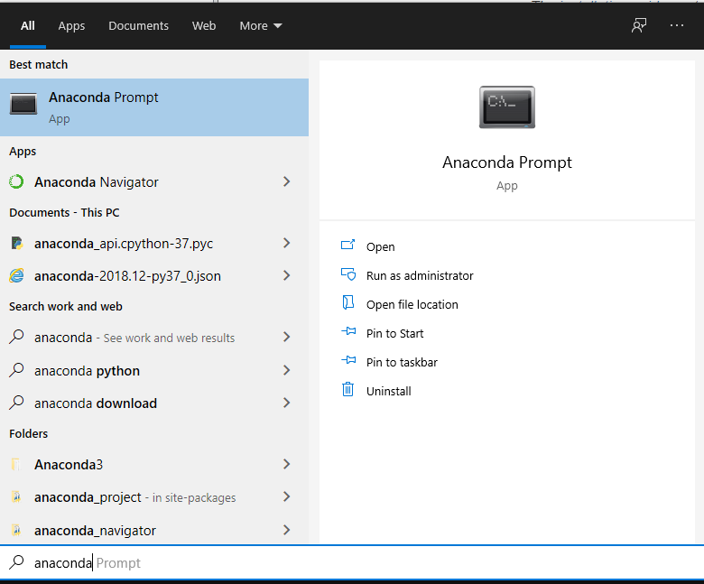
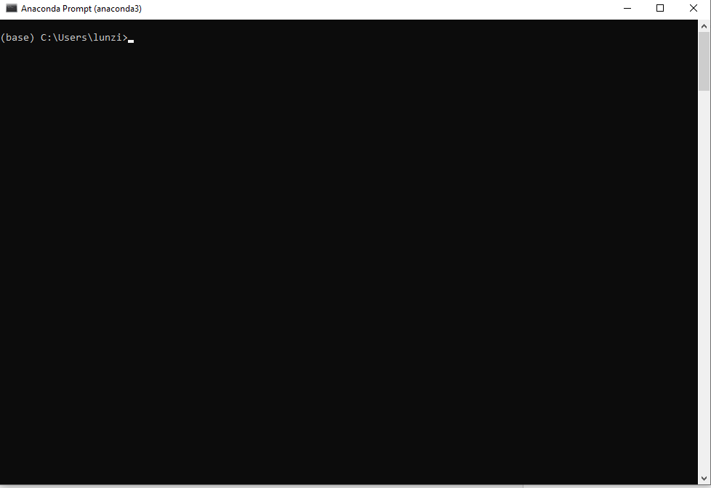
Set up guide
Open anaconda prompt
Search on windows for anaconda prompt

Slide 12
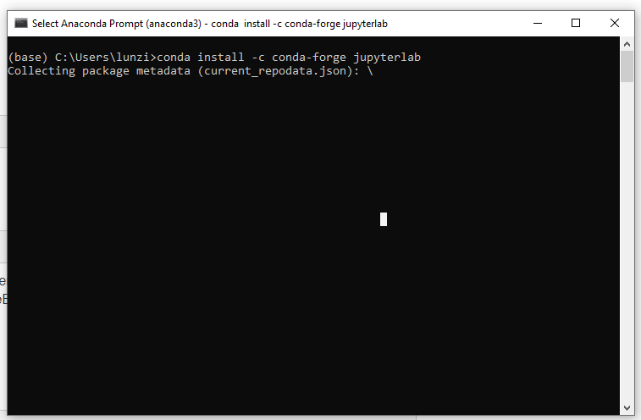
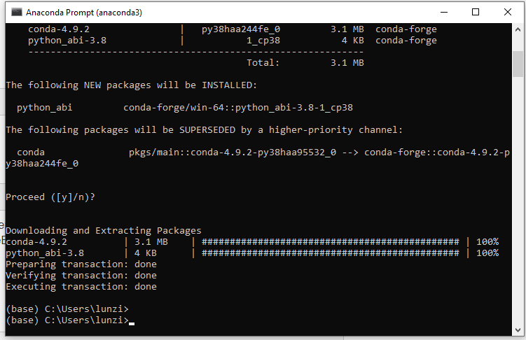
Set up guide
The anaconda prompt will look like the left image below now.
Let it load until it is complete (right image).

Slide 13
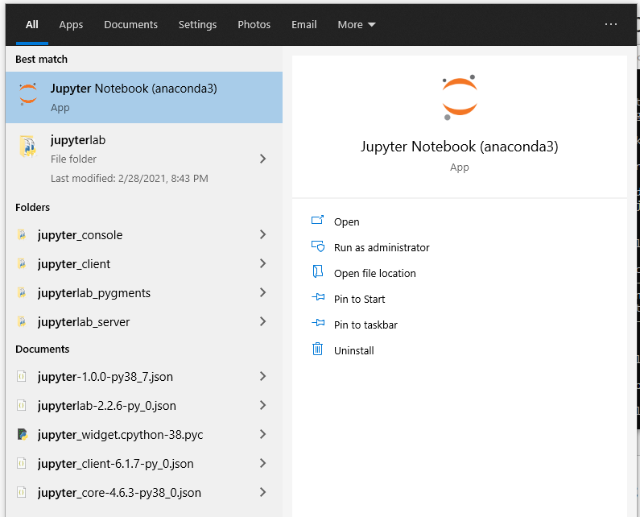
Set up guide
When everything is complete, jupyter notebook will have been successfully installed!
You can search jupyter notebook in windows and it should appear.

Slide 14
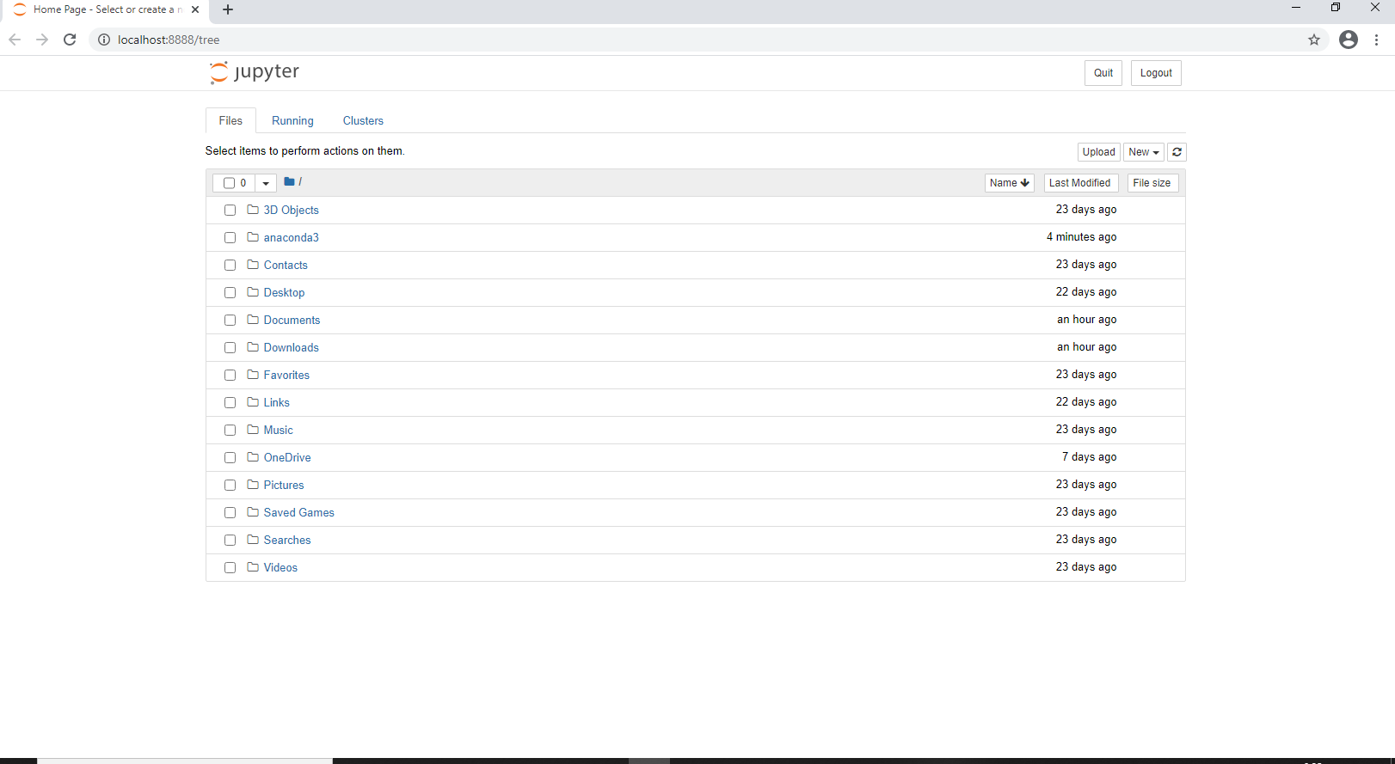
Set up guide
Upon opening jupyter notebook, you will see the below page.

Slide 15
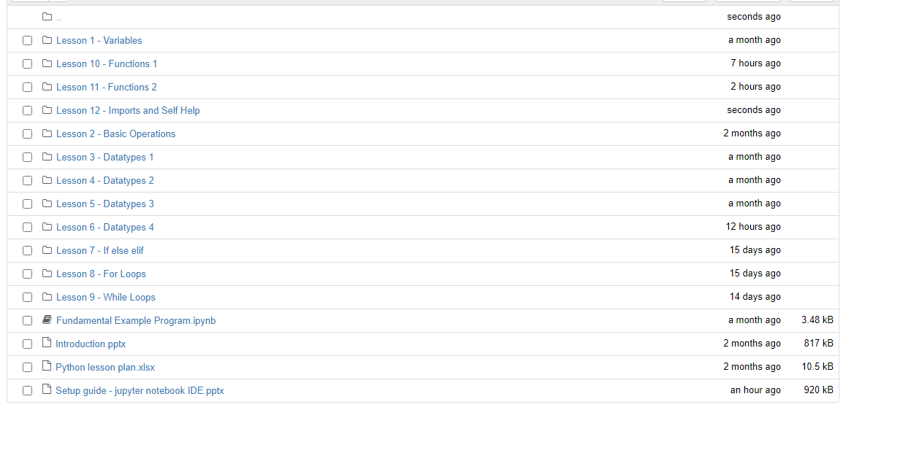
Set up guide
Locate the folder that has the course schedule.
It should look like this

Slide 16
THANK YOU!

